Slide 1
Optimize Outbox pattern
Write observable code and think asynchronously
Author: Søren Schwartz

Slide 2
Agenda
Outbox pattern
Observable code
Exercise

Slide 3
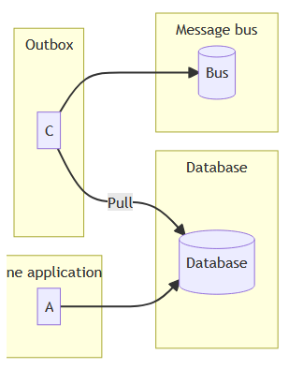
Outbox pattern

Slide 4
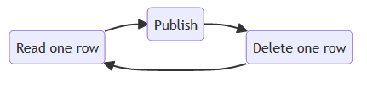
Simple design

Slide 5
What can you do to optimize?

Slide 6
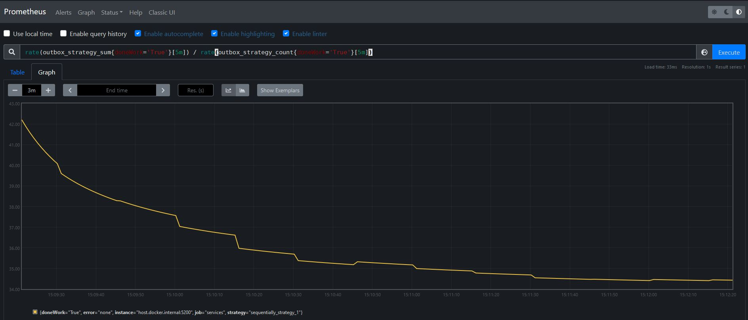
Metrics

Slide 7
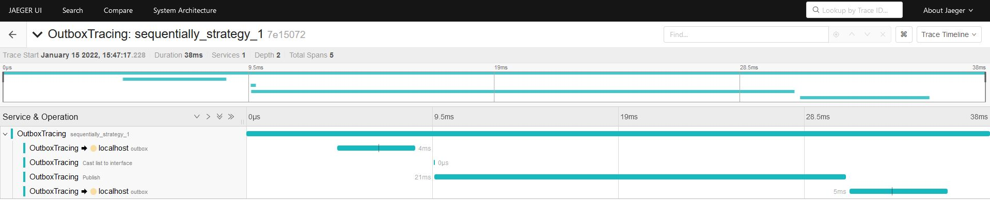
Tracing

Slide 8
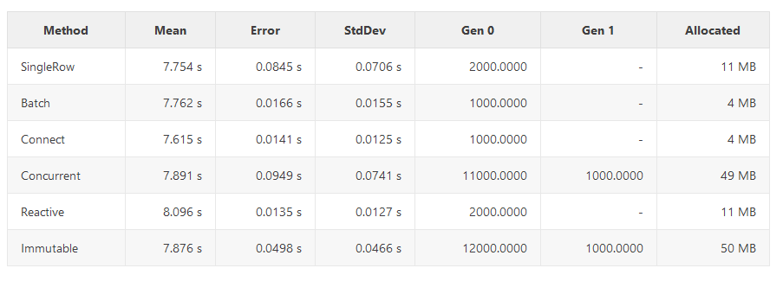
Benchmark

Slide 9
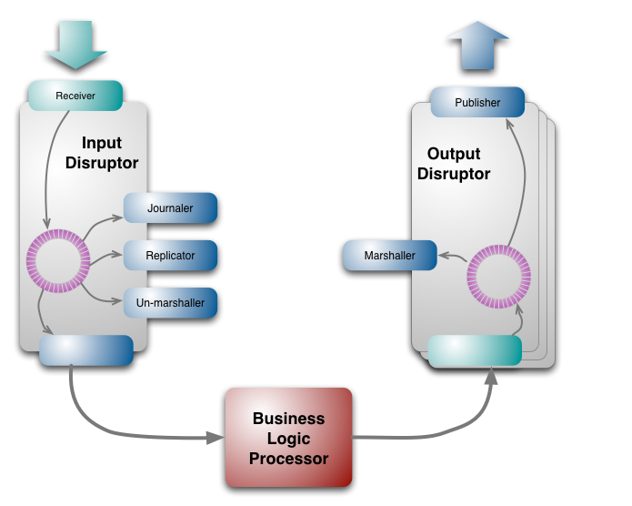
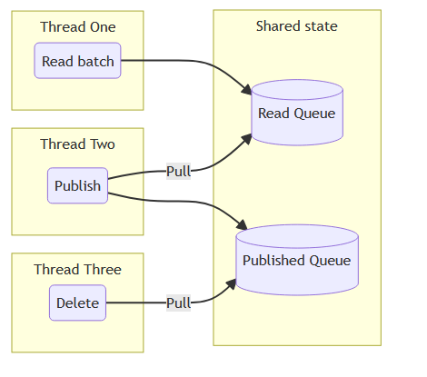
Exercise
Beat the simple design!
Think asynchronously

Slide 10
Instructions
Github https://github.com/3schwartz/StudyGroup/tree/main/Outbox
Pair programming
Last 20 min. we run benchmark and see which made the fastest

